Slide 1


SQC MINI PROJECT
Amirta V 21060641004
Bindu J 21060641011
Pushpak Bhonde 21060641033
Samruddhi Hindlekar 21060641041
Sarvesh Sawant 21060641044

Slide 2




TABLE OF CONTENT
1) About the data.
4) Applications
2) CUMSUM Chart.
5) Result and Conclusion.
3) Gage R & R Analysis.

Slide 3

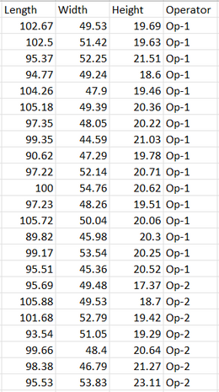
ABOUT THE DATA
20 operators are measuring the dimensions of the single product the length , breadth and height and the measurements are taken for 16 units.
Glimpse of the data:

Slide 4
CUSUM CHARTS
A cumulative sum chart (CUSUM) is a type of control chart used to detect the deviation of the individual values or subgroup mean from the adjusted target value
The basic advantage of CUSUM chart is that it is more sensitive to the small shift of the process mean when compared to the Shewhart charts
As our Data consisted observation was from 20 different operators CUSUM was used to identify if there was shift in mean with the change in operator

Slide 5
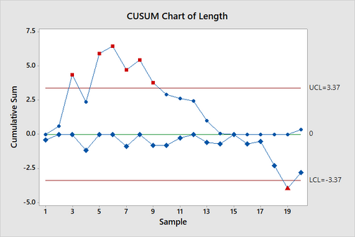
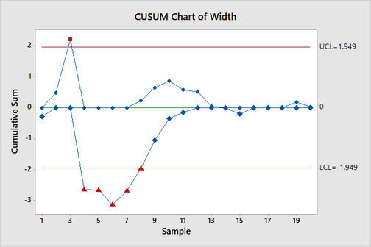

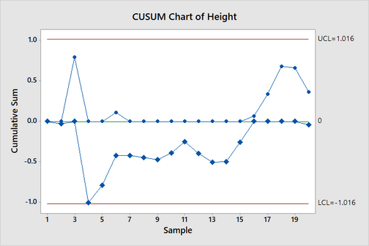
CUSUM CHARTS
SHIFT IN MEAN OF LENGTH
SHIFT IN MEAN OF WIDTH
For length there is an upward shift in mean for operator 2,4,5,6,7 and 9 and downward shift in mean for operator 19.
For width there is upward shift in mean for operator 3 and downward shift in mean for operator 4,5,6,7 and 8.
For height there is no significant shift in mean but operator 4 has near significant downward shift in mean.
SHIFT IN MEAN OF HEIGHT

Slide 6

GAGE R & R
R & R
Repeatability
What is a gage?
A gage is a tool for measurement.
When is it used?
Gage R&R is very important when new workers are assigned, new tools are used, or any significant process change.
Variation between successive measurements of the same part, same characteristic, by the same person using the same gage.
Reproducibility
Variation seen in measurements taken by different people on the same part, using the same tool.

Slide 7

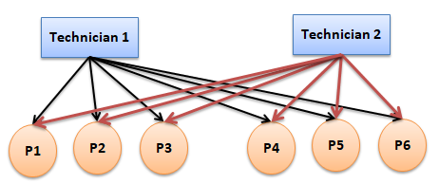
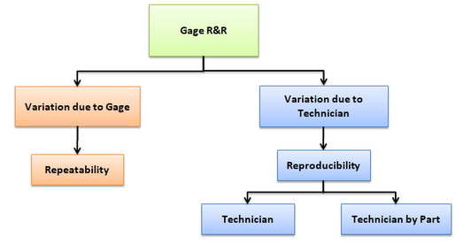
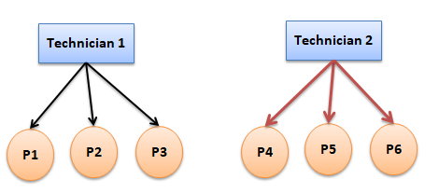
1.CROSSED GAGE R&R
Each operator measures each part
3. EXPANDED GAGE R & R
2. NESTED GAGE R & R
Each operator measures different parts
More factors than operator and part are considered.
TYPES OF GAGE R & R

Slide 8

METHODS FOR GAGE R & R
Three methods to perform Gage R & R:
Range Method: Provides a quick approximation of measurement variability but doesn't compute measurement system repeatability and reproducibility.
Average and Range method: Used for only crossed Gage R&R. Provides estimate of measurement system's variability and also the repeatability and reproducibility.
ANOVA: Most widely used method and gives high accuracy for estimates of measurement system reproducibility. It also quantifies the interaction effect between the operators and the parts.

Slide 9
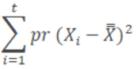
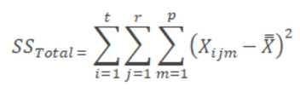
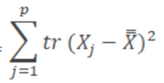
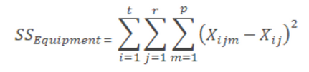
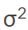
R & R VARIATION USING ANOVA METHOD
t=Number of operators (22)
r= Number of trials (16)
p= Number of parts (3)
Total SS = SS(Operators) + SS(Parts) + SS(Operation*Parts) + SS(Equipment)
SS(Operators) =
SS(Parts) =
SS(Operation*Parts) = SS(Operators) + SS(Parts) + SS(Equipment) - Total SS
(Repeatability) = MSS (Equipment)
(Operators*Parts)=(MSS(Operators*parts)-MSS(Equipment))/r
(Parts)=(MSS(Parts)-MSS(Operators*parts))/(r*t)
(Operatirs)=(MSS(Operators)-MSS(Operators*parts))/(r*p)
Repeatibility=
(Repeatability)
Reproducibility=
(Operators) +
(Operators*Parts)
Total Gage R&R=
(Repeatability) +
(Operators)

Slide 10
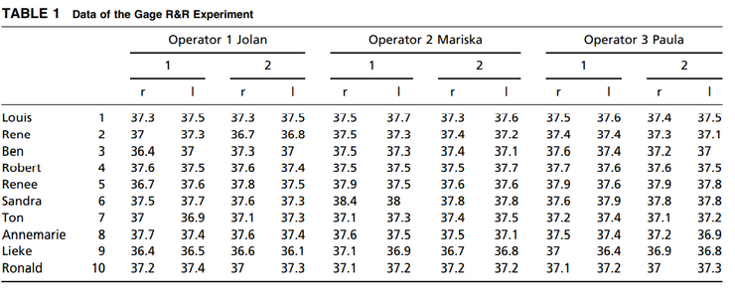
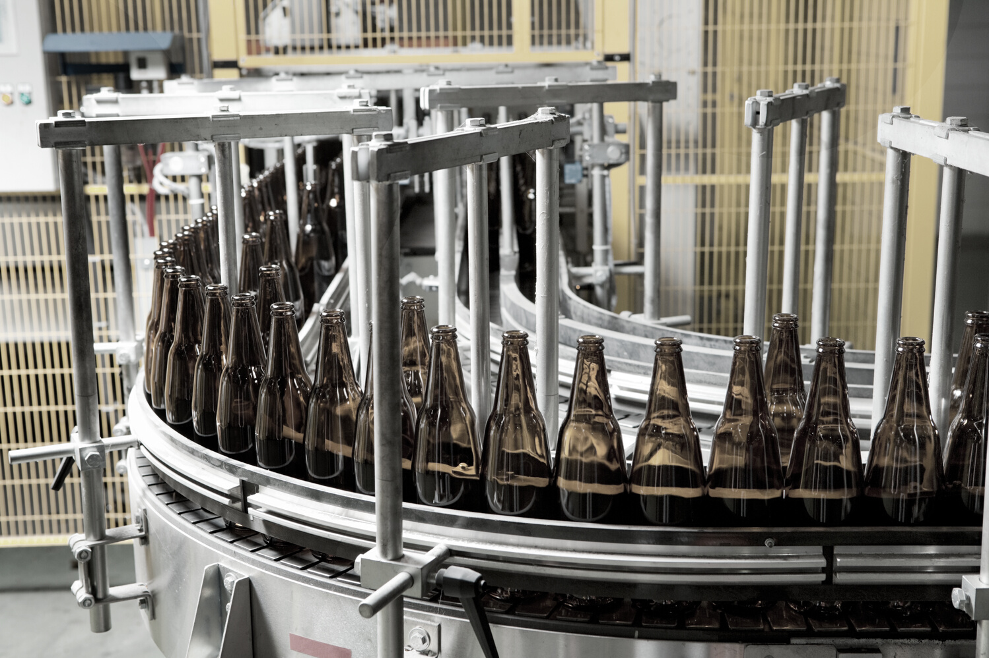
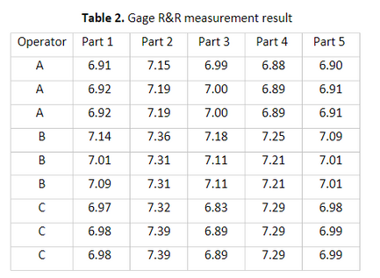
APPLICATIONS
Application in Hospitals:
Application in Automotive Industry:

Slide 11
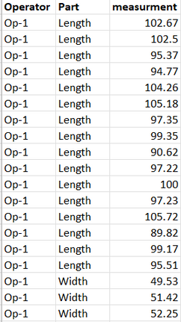
MINITAB ANALYSIS
Let us obtain the output in Minitab !
Hypothesis for ANOVA:
H01: There is no significant difference in the mean of part measurements.
H11: There is a significant difference in the mean of part measurements.
H02: There is no significant difference in the mean of operators measurements.
H12: There is a significant difference in the mean of operators measurements.
H03: There is no interaction effect between parts and operators.
H13: There is an interaction effect between parts and operators.
Rearranged data used for analysis in Minitab

Slide 12
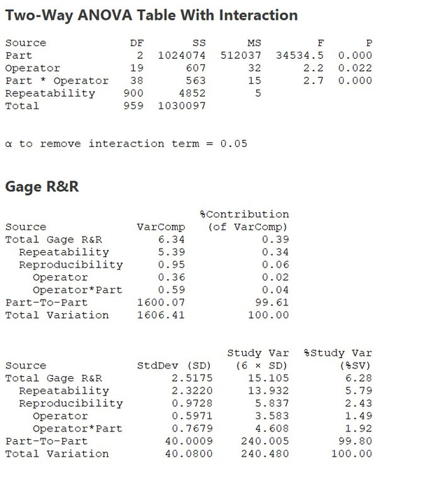
GAGE R & R - OUTPUT WINDOW SESSION
ANOVA AND GAGE R & R

Slide 13
GAGE R & R - OUTPUT WINDOW SESSION
1) From ANOVA Table
There is significance difference in the mean between parts , operators and there is interaction effect of part & operator.
2) Gage R & R
Percentage Contribution:
Total Gage R & R< 1% - Measurement System is acceptable.
Percentage Study Variance:
Total Gage R & R< 10% - Measurement System is acceptable

Slide 14
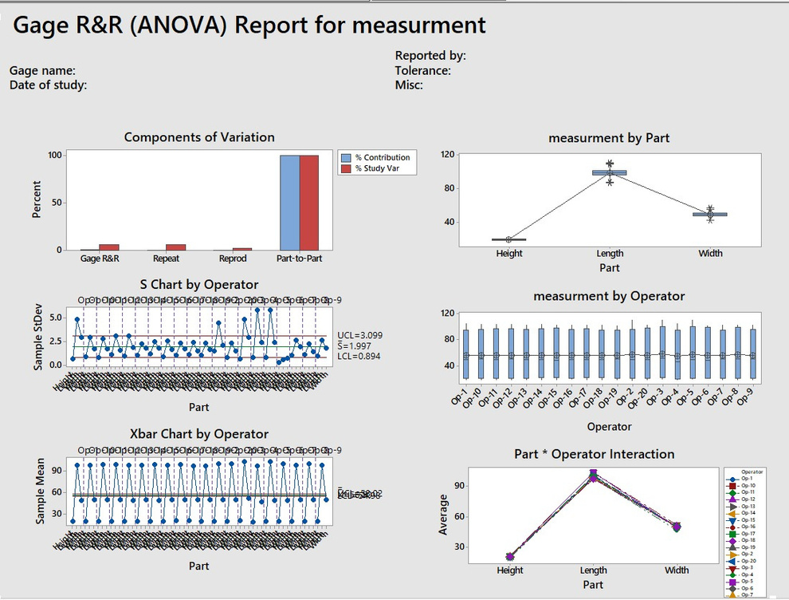
GAGE R & R - OUTPUT GRAPHICAL SESSION
GAGE R & R - GRPAHICAL SESSION

Slide 15
GAGE R & R - OUTPUT GRAPHICAL SESSION
1) Components of Variation
Most variation is due to difference in parts.
2) Measurement by part
The distribution of Length, Breadth and Width are different from one another.
3) S and Xbar Chart
Most points out of control- Variation is mainly due to the difference between parts.
4) Measurement by operators
Difference in mean starts after operator 20.
5) Parts and Operator Interaction
There is significant interaction between parts and the operator

Slide 16
REFERENCES
Hessing, T. (). Gage Repeatability and Reproducibility (R&R). sixsigmastudyguide.com.
https://sixsigmastudyguide.com/repeatability-and- reproducibility-rr/
Roberto Salazar. Six Sigma Gage R&R Analysis with R. Towards Data Science.com.
https://towardsdatascience.com/six-sigma-gage-r-r-analysis-with-r-8a1eff6ed94b
GERGER, Ö. G. D. A. Conducting a Gage R & R Study: An Application Example in Automotive Industry.
Erdmann, T. P., Does, R. J., & Bisgaard, S. (2009). Quality quandaries*: a gage R&R study in a hospital. Quality Engineering, 22(1), 46-53.
[LEARN & APPLY : Lean and Six Sigma]. (2019, April 28). GRR - Gage R&R Study (Crossed): MSA Tools with Examples | GRR Study.YouTube. https://www.youtube.com/watch?v=6sRN1lCTqSM

Slide 17

THANK YOU

